Slide 1


DRUG PREDICTION
SHARAN KUMAR

Slide 2

Agenda
Introduction
Problem Statement
Data Description
Data Analysis and Model Building
Conclusion & Actionable Insights

Slide 3
Introduction
inLab is a client for this project is a pharmaceutical company.
Their research and development team have recently developed five types of drugs to fight against chronic throat infection.
They want to quickly release the drug in the market so that they could cure people and increase revenue for the company.
The drug which has a higher concentration of chemicals should be given to those groups of people whose health report passes some criteria as suggested by the R&D team.
Current Scenario:
The R&D group has invited some groups of people to test the drug, but going through each person’s health report might take a lot of time and cause a delay in launching the drug in the market.

Slide 4
Agenda
Introduction
Problem Statement
Data Description
Data Analysis and Model Building
Conclusion & Actionable Insights

Slide 5
Problem Statement
The current process suffers from the following problems:
Testing phase takes a lot of time and it's done manually because they need to carefully examine each person for the side effects.
Most of the crucial time is being wasted in checking each person’s health report and dispensing specific drugs according to the health metric as suggested by the R&D team.
This process is time-consuming and wastage of resources.
My Role:
given dataset containing the health report of the people from the test group.
My task is to build a multi-class classification model using the dataset.
Because there was no machine learning model for this problem in the company, i don’t have a quantifiable win condition, so i need to build the best possible model.

Slide 6
Agenda
Introduction
Problem Statement
Data Description
Data Analysis and Model Building
Conclusion & Actionable Insights

Slide 7
Data Description
The dataset is divided into two parts: Train, and Test sets.
Train Set:
The train set contains 160 rows and 7 columns.
The last column Drug is the target variable.
Test Set:
The test set contains 40 rows and 6 columns.
The test set doesn’t contain the Drug column.
It needs to be predicted for the test set.

Slide 8
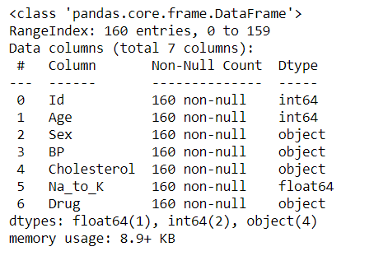
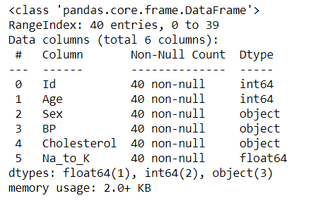
Data Description
TRAIN DATASET
TEST DATASET

Slide 9
Agenda
Introduction
Problem Statement
Data Description
Data Analysis and Model Building
Conclusion & Actionable Insights

Slide 10
Data Analysis and Model Building-1
What is EDA?
EDA is an approach to analyzing datasets to summarize their main characteristics, often with visual methods.
EDA is used for seeing what the data can tell us before the modeling task.
It is not easy to look at a column of numbers or a whole spreadsheet and determine important characteristics of the data.
EDA techniques have been devised as an aid in this situation.

Slide 11
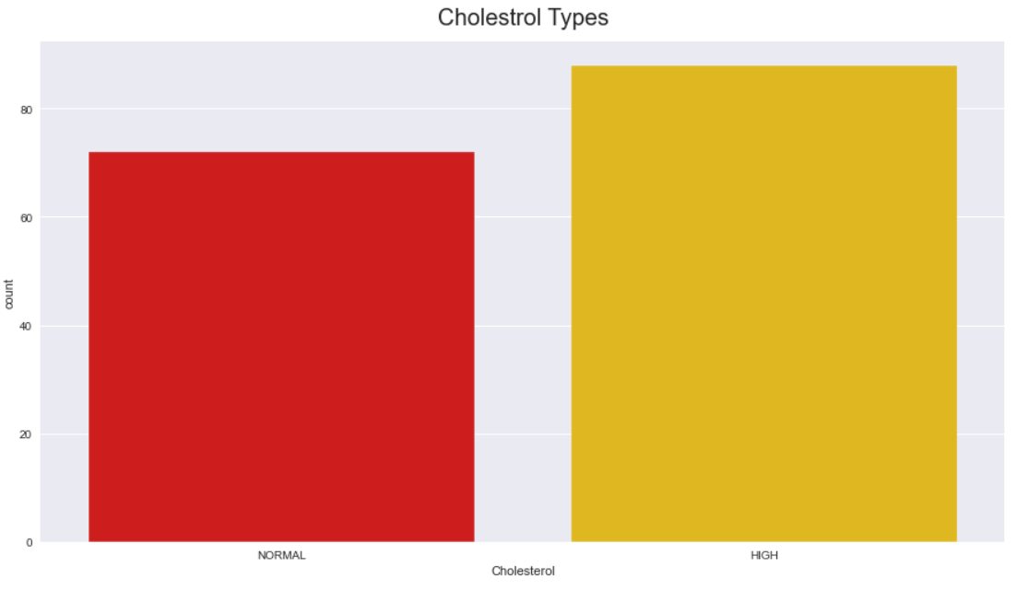
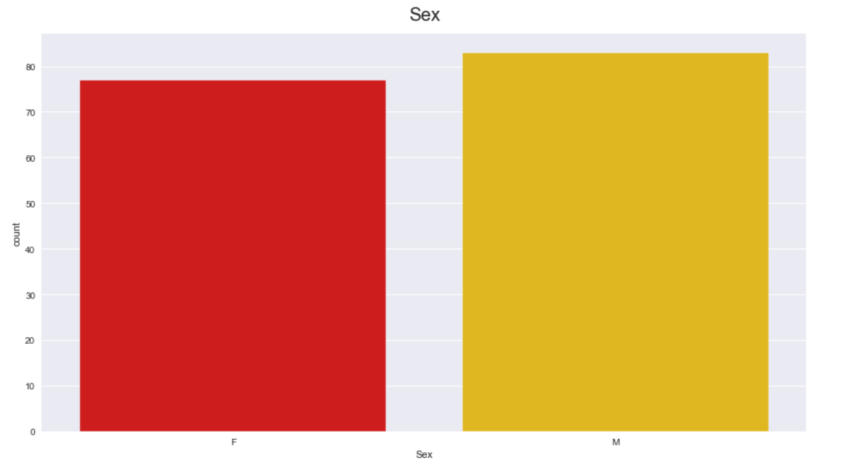
Data Analysis and Model Building-2
In Train dataset, I have plotted bar graph for representing each Columns
In Cholesterol Column, Peoples have High Cholesterol and Normal is Less.
In Sex Column, Males are higher compared to Females.

Slide 12
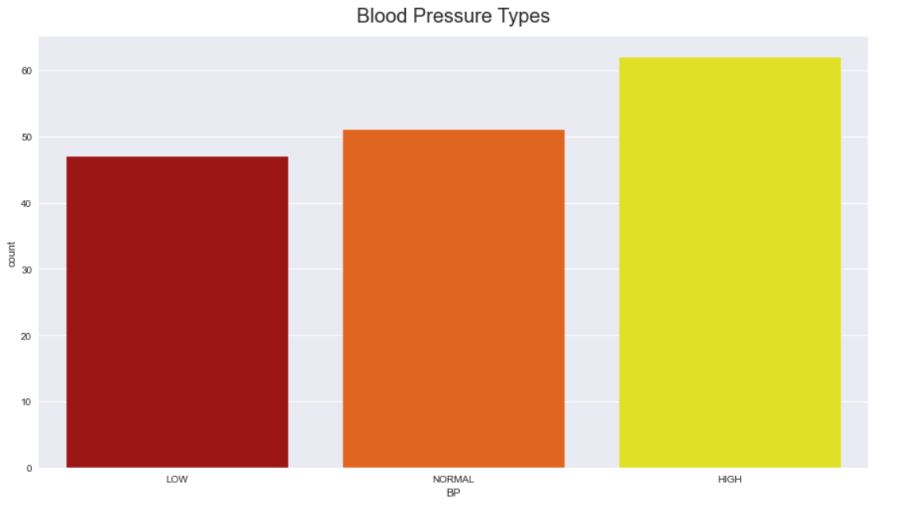
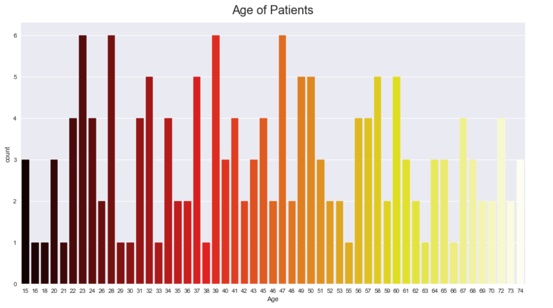
Data Analysis and Model Building-2.1
In Blood Pressure Column, count of peoples have High BP is more , Normal is medium and Low is Less.
In Age of Patients Column, Age of patients 23, 28, 39 and 47 is higher.

Slide 13
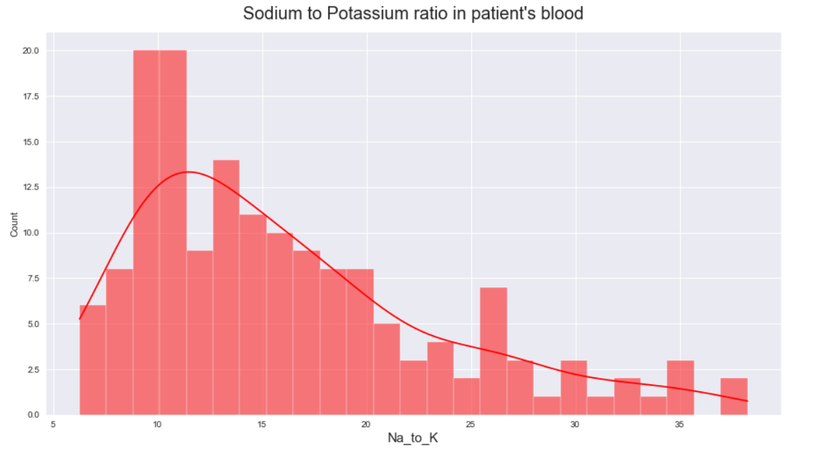
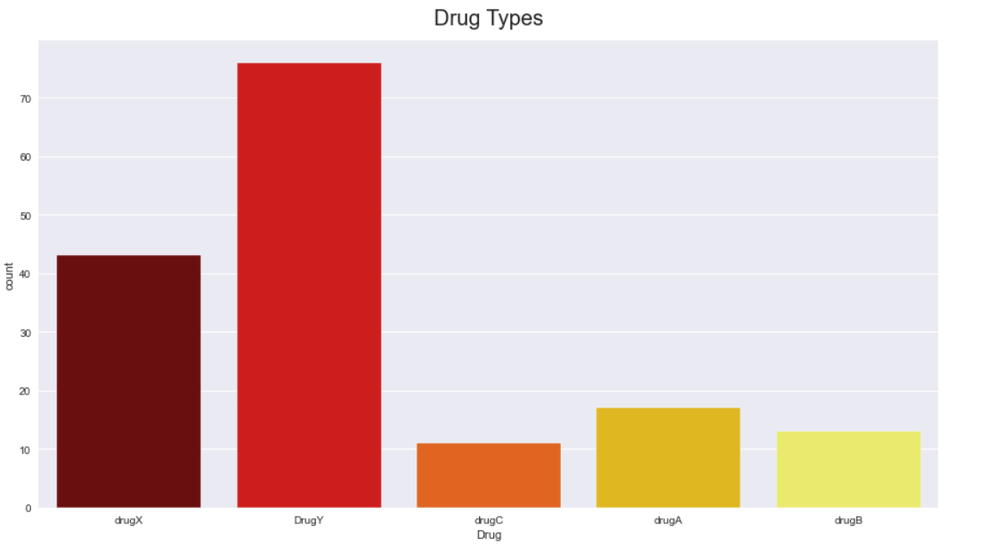
Data Analysis and Model Building-2.2
In Na_to_K Column, count of peoples have higher range from 7.xx to 15.xx
In Drug Column, DrugY has higher count compared to other Drugs.

Slide 14
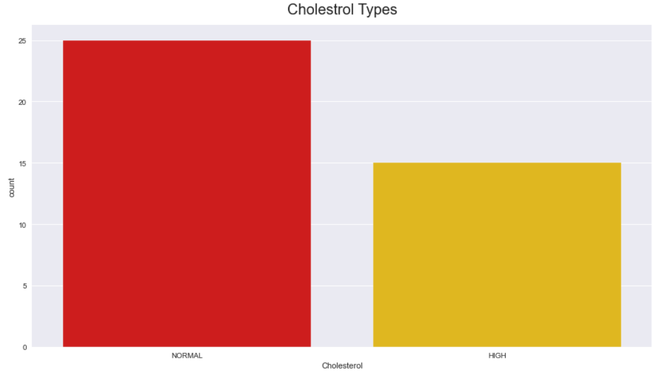
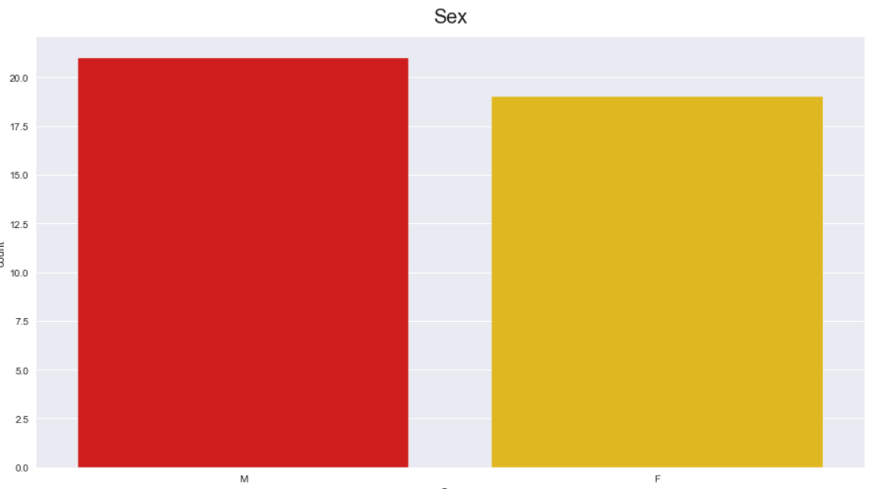
Data Analysis and Model Building-3
In Test dataset, I have plotted bar graph for representing each Columns
In Cholesterol Column, Peoples have High Normal Cholesterol and High Cholesterol is Less.
In Sex Column, Males are higher compared to Females.

Slide 15
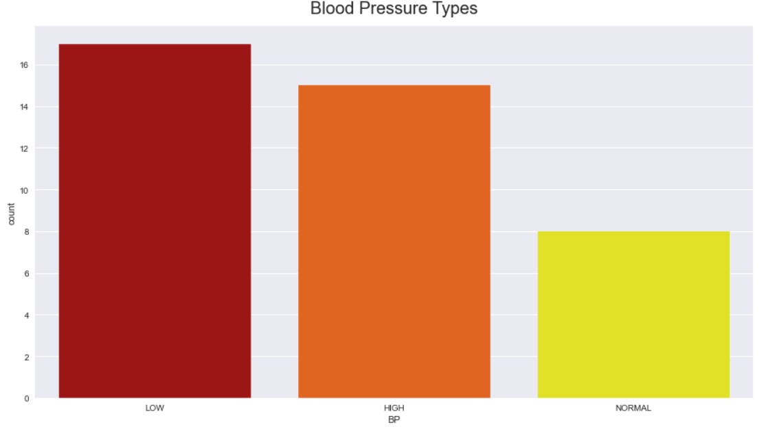
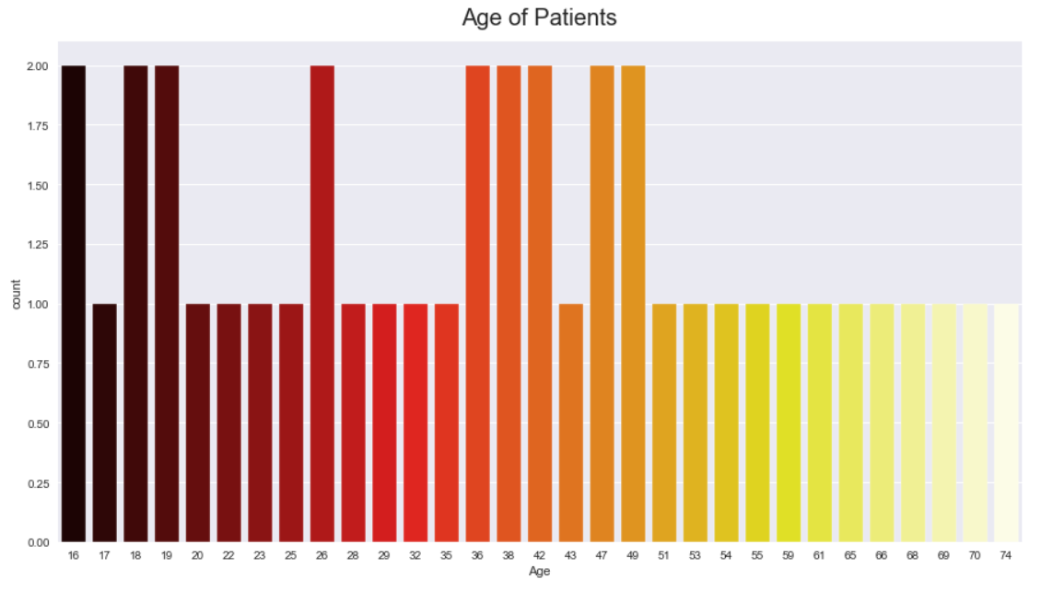
Data Analysis and Model Building-3.1
In Blood Pressure Column, count of peoples have Low BP is more , Normal is less and High is medium.
In Age of Patients Column, Age of patients 16,18,19,26,36,38,42,47 and 49 is higher.

Slide 16
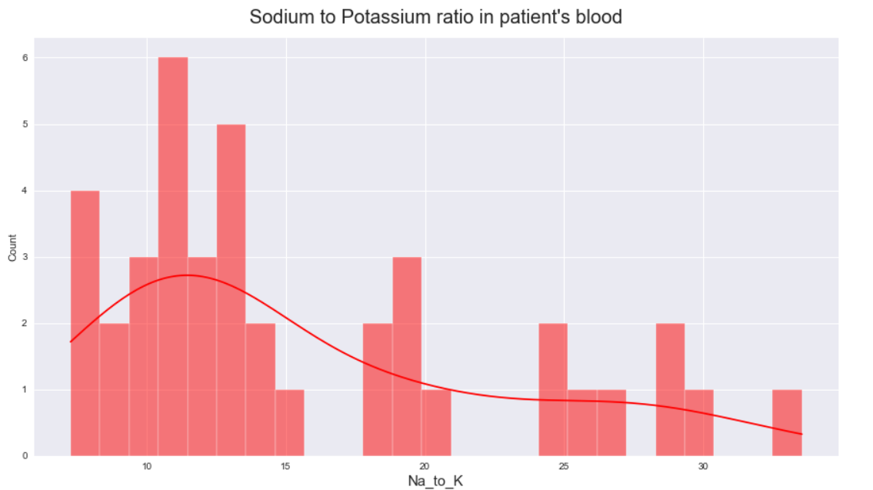
Data Analysis and Model Building-3.2
In Na_to_K Column, count of peoples have higher range from 10.xx to 13.xx

Slide 17
Agenda
Agenda
Introduction
Problem Statement
Data Description
Data Analysis and Model Building
Conclusion & Actionable Insights

Slide 18
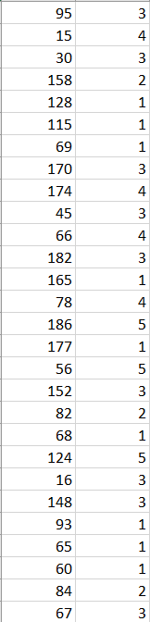
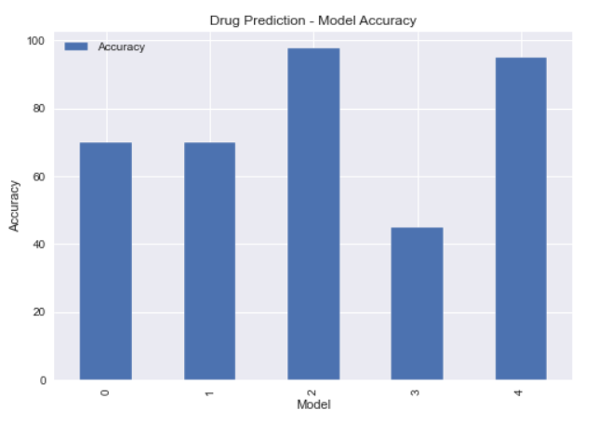
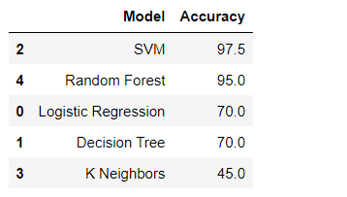
Conclusion and Actionable Insights

Slide 19

THANK YOU

